Slide 1


Slide 2
About today…
JavaScript
Fetch API
Async Data Fetching

Slide 3

API

Slide 4
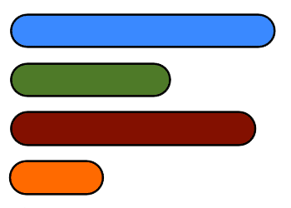
Introduction to Asynchronous JavaScript
What is Fetch API?
A modern JavaScript method for making HTTP requests
Built-in and available in most modern browsers
Why Use Fetch API?
Simplifies the process of fetching resources asynchronously
Replaces older techniques like XMLHttpRequest
Key Features
Returns a Promise
Allows easy handling of requests and responses

Slide 5

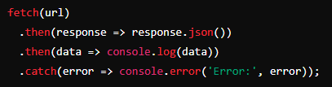
Basic Syntax of Fetch API
Basic Fetch Request
Explanation
fetch(url)
Simplifies the process of fetching resources asynchronously
.then(response => response.json())
Converts the response to JSON
.then(data => console.log(data))
Processes the JSON data
.catch(error => console.error('Error:', error))
Handles any errors

Slide 6
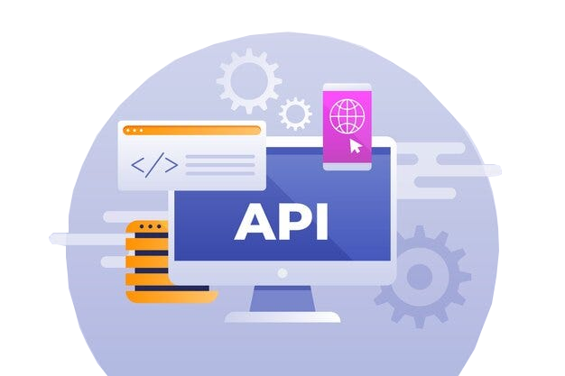
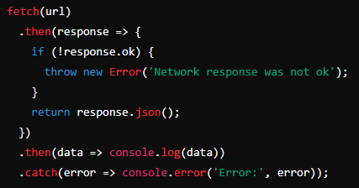
Handling Responses
Response Object
Represents the response to a request
Common methods
.json()
Parses JSON response
.text()
Reads response as text
.blob()
Reads response as a binary large object
Example
Checks if the response is OK before parsing

Slide 7
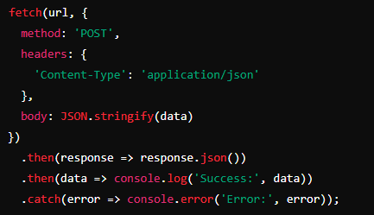

Making POST Requests
Syntax
Explanation
method : 'POST'
Specifies the request method
headers
Sets the request headers
body
Sends the request body, usually inJSON format

Slide 8
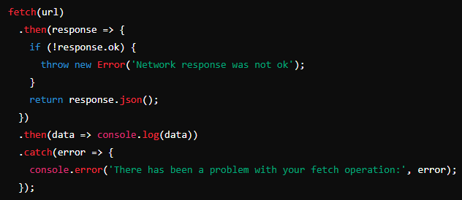
Fetch API Error Handling
Common Errors
Network errors
API errors (e.g., 404, 500)
Handling Errors
Explanation
Check response status with response.ok
Use .catch() to handle errors

Slide 9
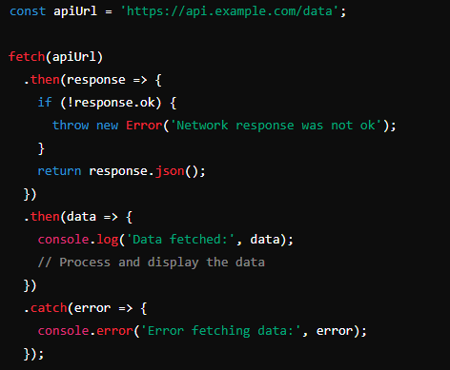

Practical Example
Fetching Data from an API
Example
Explanation
Demonstrates a complete fetch operation from an API
Includes error handling and data processing

Slide 10
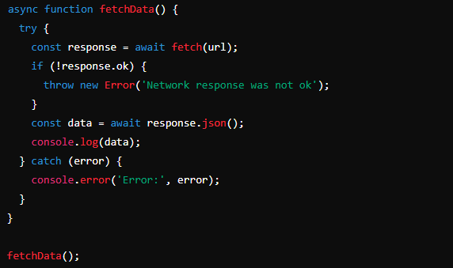
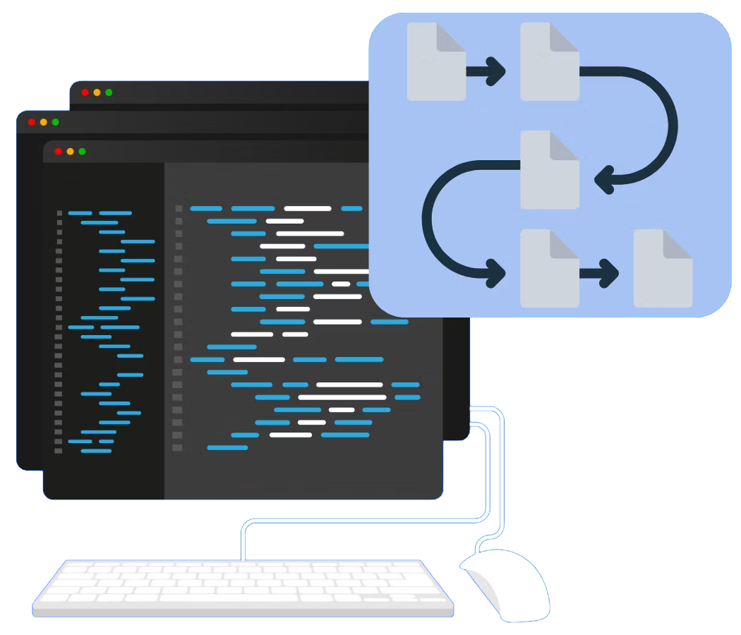
Async/Await with Fetch API
Syntax
Explanation
async function
Allows the use of await
await fetch(url)
Waits for the fetch request to complete
try/catch block
Handles errors gracefully

Slide 11

What does the Fetch API return?
A Promise
How do you handle a successful fetch response?
By chaining .then() methods to process the response
What method would you use to convert a response to JSON?
.json()
How can you handle errors in a fetch request?
Using a .catch() method or a try/catch block with async/await
What HTTP method would you use to send data to a server?
POST

Slide 12
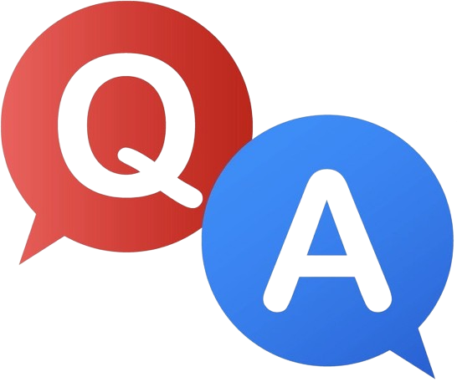

Slide 13

Task
Build a simple web page that fetches and displays data from a public API using JavaScript

